Slide 1

Telecom Customer Churn Analysis

Slide 2
INTRODUCTION
In today's competitive business environment, retaining customers is crucial for long-term success. Churn analysis is a key technique used to understand and reduce this customer attrition. It involves examining customer data to identify patterns and reasons behind customer departures. By using advanced data analytics . This knowledge allows companies to take proactive steps to improve customer satisfaction and loyalty.

Slide 3
Project Targets
Created an entire ETL process in a database & a Power BI dashboard to utilize the Customer Data and achieve below goals:
-Visualize & Analyze Customer Data at below levels
-Demographic
-Geographic
-Payment & Account Info
-Services
-Study Churner Profile & Identify Areas for Implementing marketing campaigns

Slide 4
DASHBOARD

Slide 5
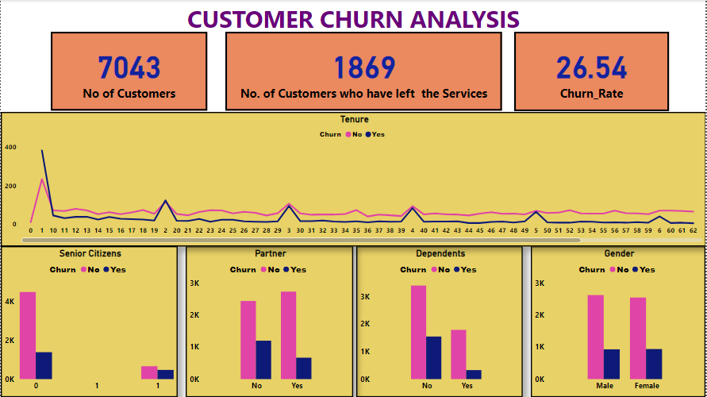

Slide 6
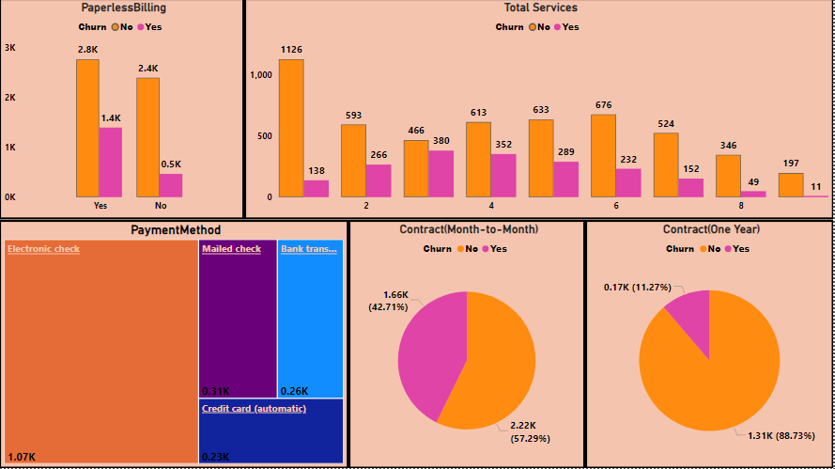

Slide 7
KEY INSIGHTS
Churn Rate:27.0%
Highest Churn by Internet Type: Fiber Optic at 41.1%
Top Churn by State: Jammu & Kashmir at 57.2%
Primary Churn Categories: Competitive pressure and customer dissatisfaction.

